Slide 1
CSI342 Systems and Design
Lecture 3 : Project management

Slide 2
Learning Objectives
At the end of this lecture, students should be able to:
Define project management
Identify the responsibilities of the project manager
Identify the details of a project plan, management tools
Apply project management tools

Slide 3
Introduction
Project: A planned undertaking of related activities to reach an objective that has a beginning or an end.
Stakeholder: A person who has an interest in a new or existing Project
Project Sponsor: A member of an organization or department that initiates a project request and is responsible for high level support of the project.
Project Manager: A person with diverse set of skills-general management, leadership, technical, conflict management and is responsible for initiating, planning, executing, controlling & monitoring and closing down a project.
3

Slide 4
Overview of Project Management
Project management
Planning, scheduling, monitoring & controlling, and reporting on information system development
Project Management is the process of planning and controlling the development of a system within a specified time frame at a minimum cost with the right functionality
What shapes a project?
Successful projects must be completed on time, within budget, meet requirements, and satisfy users

Slide 5
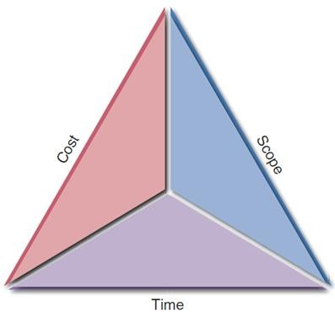
Overview of Project Management
What is a project triangle?
Challenge: find optimal balance among the factors
Any change in one leg will affect the other legs

Slide 6
Skills of Project Manager?
The project manager is a systems analyst with a diverse set of skills- management, leadership, technical, conflict management, and customer relationship- who is responsible for initiating, planning, executing, and closing down a project.

Slide 7
Responsibilities of a Project manager
A project manager has the primary responsibility for managing the project
Most managers take responsibility at some stage of the project for the following activities:
Proposal writing
Project planning and scheduling
Project cost
Project monitoring and review
Personnel selection and evaluation
Report writing and presentation

Slide 8
Project managers responsibilities
Proposal Writing- this is the first stage in a software project. The proposal describes the objectives of the project and how it will be carried out. It usually includes costs and schedule estimates and justifies why the contract should be awarded to a particular organization or team
Project planning and scheduling – this is concerned with identifying the activities, milestones and deliverables produced by a project. A plan is drawn up to guide the development towards the project goals. Necessary costs and resources estimates are also included.

Slide 9
Project manager’s responsibilities
Milestones are recognizable end points of a software process activity. At each milestone, there should be a formal output, such as a report that can be presented to management. Milestones should represent the end of a distinct, logical stage in the project.
A deliverable is a project result that is delivered to the customer. It is delivered usually at the end of some major project phase such as specification or design.

Slide 10
Project managers responsibilities
Project monitoring and reviews – Monitoring is a continuing project activity. The manager keeps track of the progress of the project and compare actual and planned progress and costs. Formal project management reviews are usually established to ensure the overall progress and technical development align with the goals of the organization paying for the software.
Personnel selection – managers have to select qualified and skilled people to work on projects
Report writing – managers are usually responsible for reporting on the project to both the client and contractor organization.

Slide 11
Details of Project Plan
A project plan sets out the resources available to the project, the work breakdown, and a schedule for carrying out the work
Most project plan documents would include:
Introduction: brief description of objectives of the project and sets out the constraints (eg budget, time) that affect the project management
Project organization : the way in which the development team is organized, the people involved and their roles in the team
Risk analysis : describes possible project risks, the likelihood of these risks and the risk reduction strategies proposed

Slide 12
Details of a project plan
4) Hardware and software resource requirements : specifies the hardware and support software required to carry out the development. If hardware has to be bought, cost estimates and delivery schedule are included
5) Work breakdown : sets out the break down into activities and identifies the milestones and deliverables associated with each activity
6) Project schedule : shows the dependencies between activities, the estimated time to reach each milestone and the allocation of people to activities
7) Monitoring and reporting mechanism : defines management report to be produced, when expected and the project monitoring mechanism used

Slide 13
Project Planning & Scheduling
Identifying and Selecting System Development Projects: This process can be performed by
member of top management – Projects identified by top management often have a strategic organizational focus
Steering committee - projects identified by a steering committee reflect the diversity of the committee members, hence such projects have cross functional focus
User department – Projects identified by a user department often have a narrow tactical focus
Development group or senior IS manager - often this is the case with which existing hardware and systems will integrate

Slide 14
Skills Required in a Project Manager
Leadership – influencing other team members towards attaining a common goal
People mgt – managing team for effective team performance
Effective communication – with management, users & team
Negotiation – with customers, project team, management
Conflict management – smoothing out personality differences
Planning –defining and sequencing activities
Estimating –time and cost of activities and whole project
Problem solving -designing solutions to problems
Time management –monitoring progress
Creative thinking –coming up with new ideas or concepts

Slide 15
Project Management Process
Project Management Has 4 phases:
Project initiation - Realization of a business need
Project planning - Detailed plans of how to carry out project work
Project execution and control - Doing the work to deliver the product; ensuring the project stays on track
and taking corrective measure to ensure it stays so
Project closure - Formal acceptance of the deliverables
Releasing all resources that were used in the project

Slide 16
Project Initiation
i. What is the problem?
- Identify the problem that needs to be solved
ii. What are the available resources
- Include staff time, appropriate tools, and capital
iii. What are the project’s risks?
-Often recorded as part of the feasibility study
iv. Establish PM environment and project workbook

Slide 17
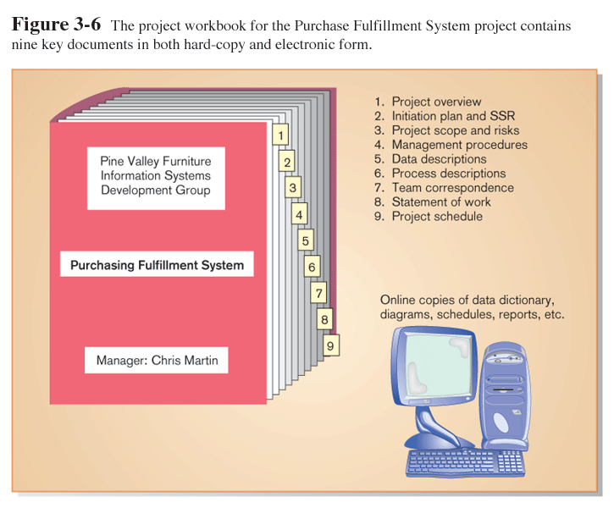

Slide 18
Project Planning
Has an effect on the project outcome
Involves defining clear discreet activities and the work needed to complete each activity
Requires assumptions about availability of resources
Helps avoid unpleasant surprises during the project
Resource planning –getting the right resources and tools at the right time
Basis of controlling the project
Helps compare what has been achieved against what was originally planned
Helps identify problems and risks

Slide 19
Some deliverables of Planning
Statement of Work (SOW)
“Contract” regarding deliverables & time estimates
The Baseline Project Plan (BPP)
Preliminary Budget: Cost-benefit analysis
Work Breakdown Structure (WBS)
Division of project into manageable and logically ordered tasks and subtasks
Scheduling Diagrams
Gantt chart
Network diagram

Slide 20
Project Execution
Putting the approved detailed plan into motion
Brings together resources, tasks and schedules
Involves
Executing project plan
Performing project’s activities
Monitoring progress against plan
Are we behind schedule? How could we catch up if so?
Managing changes in the plan
Coordinating people and resources
Communicating project status to various stakeholders

Slide 21
Project Monitoring & Control
Usually considered part of the execution phase
To ensure project provides an end product that meets the original objectives
Several areas to be monitored:
schedule, costs, resources & quality
Purpose is to run the project as far as possible according to the plan and schedule
In case of deviations from the plan, control actions include
Adjustments to resource allocation
Detailed re-scheduling or re-planning
Cancellation of the project

Slide 22
Project Close down
Bring the project to a successful end
Actions performed:
Close down the project
Release project resources
Conduct post-project reviews
Meet stakeholders to get consensus about status & value of project results
Write and publish final report
Close the customer contract

Slide 23
Project Management tools (Scheduling Tools)
Project scheduling involves separating the total work involved into separate activities and judging the time required to complete these activities
Managers estimate time and resources required to complete activities and organize them into a coherent sequence
When estimating schedules, do not assume that every stage will be problem free, however estimate as if nothing will go wrong, and cover anticipated problems

Slide 24
The Scheduling Process
Identify Activities
Identify Activity dependencies (Dependencies are those activities that must be completed before the following activity can begin)
Estimate resources for activities (e.g timing/duration)
Allocate people to activities
Create project charts (Activity charts and bar charts)
Go back to estimate resources for activities if need be.

Slide 25
The Work Breakdown Structure (WBS)
Decomposition of a project into manageable tasks which are logically ordered to ensure a smooth evolution between them
Often portrayed as one of the following
Graphically as a hierarchical tree
In a simple outline style
Tabular list of elements categories and tasks
Project size & complexity determines no. of tasks & level of refinement
Larger system more detailed
Helps to understand large complex projects

Slide 26
1. Requirements Collection
0. Customer Ordering Project
2. Design
3. User Documentation
4. Implementation
2.1 Screen Design
2.2 Report Design
2.3 DB Design
4.1 Programming
4.2 Testing
4.3 Installation
Example
WBS for a
Project

Slide 27
Estimating Task Durations
Project manager must estimate the duration of each task on the WBS
Must consider:
Size of project team
Experience of team members
Time, e.t.c.
Idea is to assign a single value estimation to each task
Can be difficult if task time estimates are uncertain
One approach is to use estimates on the next slide

Slide 28
Types of Duration estimates
Optimistic Duration (O)
Minimum time it would take to perform the task assuming everything goes perfectly as planned
Pessimistic Duration (P)
Maximum amount of time it will take, assuming that nearly everything will go wrong
Realistic Duration (r)
Realistic amount of time required to complete the task, assuming most likely delays
The expected time (ET) is then calculated as
ET = O + (4*r) + p
6

Slide 29
Example: (Time estimates in Weeks)
Activity | O | r | P | ET
1. Requirements Gathering | 1 | 5 | 9 | 5
2. Screen Design | 5 | 6 | 7 | 6
3. Report Design | 3 | 6 | 9 | 6
4. Database Design | 1 | 2 | 3 | 2
5. User Documentation | 4 | 6 | 7 | 5.5
6. Programming | 3 | 5 | 6 | 5
7. Testing | 1 | 3 | 5 | 3
8. Installation | 1 | 1 | 1 | 1

Slide 30
Develop a preliminary schedule
Define when each activity will be carried out and the resources available to it
Sequence of activities (& precedence relationships)
Follows time estimates for each activity
Schedule may need to be refined to include changes or extra activities to help risk management
Common tools used
PERT chart or Network Diagram
Gantt chart

Slide 31
PERT (Program Evaluation Review Technique or Network Diagram)
Used to schedule, organize and coordinate project tasks
Tasks on parallel paths can be done concurrently
Developed to simplify planning and scheduling of large and complex projects
Useful when the individual task’s time estimates are uncertain
Shows precedence
Activities to be completed before the next one begins.
Major components:
Nodes : activities
Arrows: sequencing of activities

Slide 32
ET with Preceding Activities (Dependencies)
Activity | ET | Preceding Activity
1. Requirements Gathering | 5 | -
2. Screen Design | 6 | 1
3. Report Design | 6 | 1
4. Data Base Design | 2 | 2,3
5. User Documentation | 5.5 | 4
6. Programming | 5 | 4
7. Testing | 3 | 6
8. Installation | 1 | 5,7

Slide 33
The Critical Path
PERT chart helps identify project’s critical path
Longest path through the activities
From project inception to its completion
Determines total time required for the project
Gives shortest time to complete the project
Any delays on the critical path will delay the whole project
Should be monitored regularly
All activities on this path have zero float

Slide 34
PERT Chart
8
5
2
ET=1
ET=5.5
4
ET=6
6
7
ET=2
1
ET=3
3
ET=5
ET=5
ET=6

Slide 35
Calculating Critical Path
From the above PERT chart, Calculate the Critical Path as follows:
There are 2 Paths here, namely
1, 2, 4, 6, 7,8 (Black Line)
1, 3, 4, 6,7, 8 (Red Line)
Either path gives
5+6+2+5+3+1 = 22 Weeks

Slide 36
Alternative Example
Task /Activity | Duration (days) | Dependencies
T1 | 8
T2 | 15
T3 | 15 | T1(M1)
T4 | 10
T5 | 10 | T2,T4(M2)
T6 | 5 | T1,T2(M3)
T7 | 20 | T1(M1)
T8 | 25 | T4(M5)
T9 | 15 | T3,T6(M4)
T10 | 15 | T5,T7(M7)
T11 | 7 | T9(M6)
T12 | 10 | T11(M8)

Slide 37
Using Gantt Charts for Project scheduling
Points to note
Bars represent each task or activity
The length of each bar represents the relative length of the task
Time may be indicated on the horizontal dimension
Description of activities make up the vertical dimension
Completed projects or parts may be shaded in colour different from the uncompleted
Bars representing activities are drawn to scale (i.e. the size of the bar indicate the time it will take to finish task

Slide 38
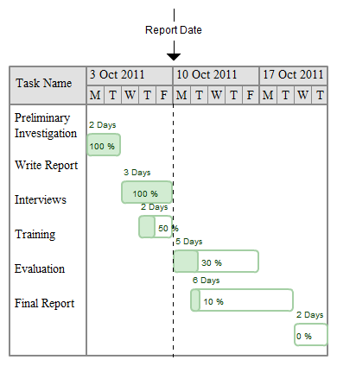
Example of Gantt chart

Slide 39
Risk Management (1 of 2)
A risk is an event that could affect the project negatively
Steps in risk management
Develop a risk management plan
Identify the risks
Analyze the risks
Qualitative and quantitative risk analysis
Qualitative risk analysis evaluates each risk by estimating the probability that it will occur and the degree of impact.
The purpose of quantitative risk analysis is to understand the actual impact in terms of dollars, time, project scope, or quality

Slide 40
Risk Management (2 of 2)
Create a risk response plan
Proactive effort to anticipate a risk and describe an action plan to deal with it
Monitor risks

Slide 41
Summary
Project Management involves 4 phases
Project Initiation
Define the Problem - Problem definition is produced after completing interviews, observations, document analysis with users (See case study Catherine catering example. Pg 87-88, Systems Analysis and Design by Kenneth Kendall)
Selection of projects – Projects come from different sources for many reasons. Not all should be selected for further study. Be clear about reasons for recommending a systems study on a project
Apart from the general considerations, there are 5 specific considerations for project selection as shown below:

Slide 42
Summary
Specific criteria for Project Selection
Backing from management
Appropriate timing of project commitment
Possibility of improving attainment of organizational goal
Worthwhile project compared with other ways the organization could invest its resources
Project planning- Plan how to execute the project as already discussed in Project management
Project execution - The concentration of the rest of the course.
Project Closure – close project formally

